Slide 1
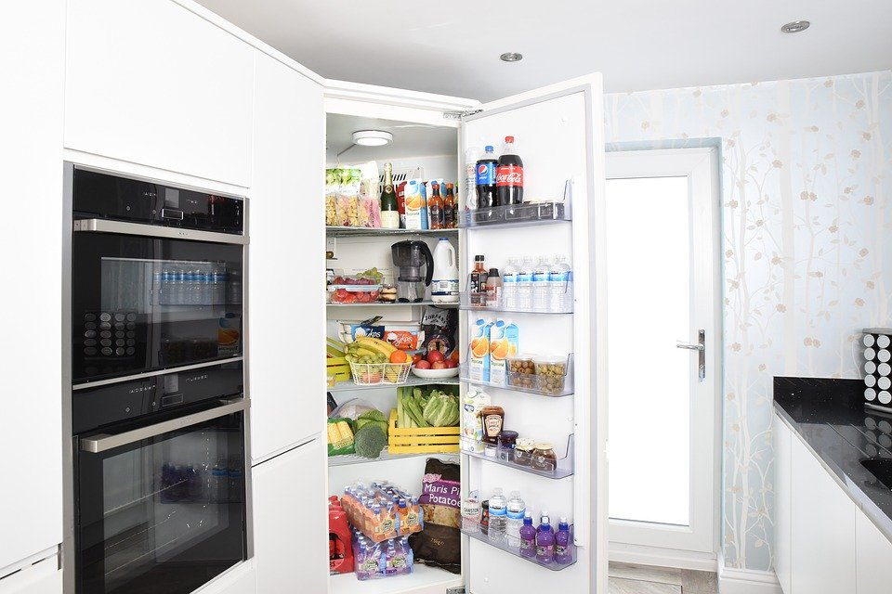
STOCK UP
Team 103

Slide 2
Team Members
Siddhita Chimote (Team Lead)
Cassidy Mcskimming (Scrum Master)
Matthew Ibrahim (Git Master)
Calvin Tam (Front-end Lead)
Kevin Dizon-Cua (Back-end Lead)
Sara Tama
Jose Pascual
Corey Russ
Team 103

Slide 3
Introduction

Slide 4
Overview
Fast and easy tool to help keep track of storables inside your refrigerator.
Offers features from tracking food, finding recipes, building shopping lists, tracking food consumption, adding meal plans etc.
Combination of helpful tools to its users like a family, elderly couple, students, professionals etc.
Customers can build lifestyles around for organizations using this application.
Motivate change and save time.

Slide 5
Agenda
Technologies
Mobile Responsiveness
DevOps
Performance
Code Management
CI / CD
Testings
Preview
Walkthrough

Slide 6
Technologies

Slide 7
Back-end
Node.js
Express (Web Framework)
MariaDB (Database)

Slide 8
Front-end
Node.js
React
Express (Web Framework)
React Native
React Native for Web
Material Components for React (Component Library)

Slide 9
DevOps

Slide 10
Production
All services are run in Google Kubernetes Engine.
When there is new commit at master branch, Docker image will be created depending on whether it’s front end or back end by Google Cloud Build.
The new image will be deployed to Google Cloud Run.
When the URL is requested, it will start and connect to the load balancer of each individual service.
We are limiting number of node pools to one in Google Kubernetes Engine to a minimum for reduced costs.

Slide 11
Development
Different folders for front and back end.
For API (back-end)
Go to corresponding directory: /csc648-03-sp20-team103/source/api
For Application (front-end)
Go to corresponding directory: /csc648-03-sp20-team103/source/application
Both ends must start and run in parallel.

Slide 12
Development (cont.)
export NODE_ENV=development # setup node environment (first-time only)
npm install # install dependencies
openssl req -nodes -new -x509 -keyout server.key -out server.cert -subj '/' # generate self-signed cert (first-time only)
sudo docker-compose up # start docker compose

Slide 13
Development (cont.)
Different ports used for development environment
API
HTTP: http://localhost:8080
HTTPS: https://localhost:8443
Application
HTTP: http://localhost:9080
HTTPS: https://localhost:9443

Slide 14
Performance

Slide 15
Caching
Since back-end is serving static files, these files can be cached on Content Delivery Network (CDN).
User requests on page loading go to CDN rather than production server.
This improves loading speed for clients.

Slide 16
Scalable Architecture
Back-end can be scalable depending on demands.
Google Cloud Run is run on-demand.
By enabling auto-scaling on node pool in Google Kubernetes Engine, all services (front and back-end) are scalable.
Could make more scalable by reducing # of queries and API calls.
Limited to 150 spoonacular API calls a day with free version.

Slide 17
Mobile Responsiveness

Slide 18
Adjustments!
Automatic width adjustment
Automatic height adjustment
Should require no user intervention
Components should stay out of sight when not needed, and be visible when useful
Drawer is always hidden
No bottom navbar
Dialogs are descriptive

Slide 19
Possibilities
The front-end can be ported to mobile app easily (e.g. iOS, Android).
It was built based on React Native.

Slide 20
Code Management

Slide 21
Git Flow
The master and develop branches are protected.
They can only be changed with a pull request.
Automated testing are available on all branches.
Feature branches diverge from develop and after completion are merged back into develop through a pull request.
Mandatory code review

Slide 22
Git Flow (cont.)
Sub-feature branches diverge from a feature branch and after completion are merged back into the feature branch through a pull request.
Optional code review
Patch branches to apply hotfixes and for milestone document submission.

Slide 23
CI / CD

Slide 24
Continuous Integration (CI)
We are using GitHub Actions for CI.
Runs on every commits and pull requests.
Able to see test results on pull requests before merging to avoid broken code.

Slide 25
Continuous Deployment (CD)
We are using Google Cloud Source Repositories, Google Cloud Build, Google Cloud Run for CD on the codes.
Google Cloud Source Repositories syncs with our repo on GitHub.
Google Cloud Build are triggered new build on every commits and pull requests on the master branch.
Every trigger builds a Docker image from master branch.
Deploys to the cluster in the Google Kubernetes Engine with Google Cloud Run.

Slide 26
Continuous Deployment (CD) (cont.)
We are using db-migrate for CD on database.
Database schema migrates by migration files using db-migrate.
Migration files are created by developers for create, modify and delete schema / tables.
Db-migrate stores all structure changes in scheme and provides functionality to revert changes specified in migration file.

Slide 27
Testings

Slide 28
Testing Frameworks
We are using these frameworks:
AVA for unit testing for Node.js code.
AVA with Enzyme for unit testing for React code.
Reasons we chose AVA over Mocha / Jest or other options:
Fast, light-weight
Simple to write
Zero configuration setup

Slide 29
AVA Features
Simple test syntax
Runs tests concurrently
Enforces writing atomic tests
No implicit globals
Includes TypeScript definitions
Magic assert
Isolated environment for each test file
Write your tests using the latest JavaScript syntax
Promise support
Async function support
Observable support
Enhanced assertion messages
Automatic parallel test runs in CI

Slide 30
Test Coverage
Back-end
Endpoints testing
Check for invalid params
Check for unauthorized requests
Check for successful cases
Check for HTTP status code returned

Slide 31
Test Coverage (cont.)
Front-end
Endpoints testing
Check for unauthorized requests
Check for authorized cases
Check for HTTP status code returned
Integration testing
Not completed

Slide 32
Preview

Slide 33
Sections
Splash
Users
Inventory
Recipes
Carts
Meal Plans

Slide 34
Splash

Slide 35
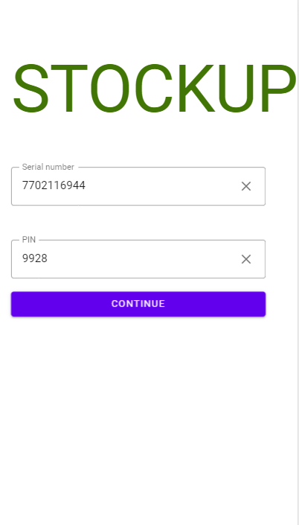
Splash Page
Registering fridge.

Slide 36
Users

Slide 37
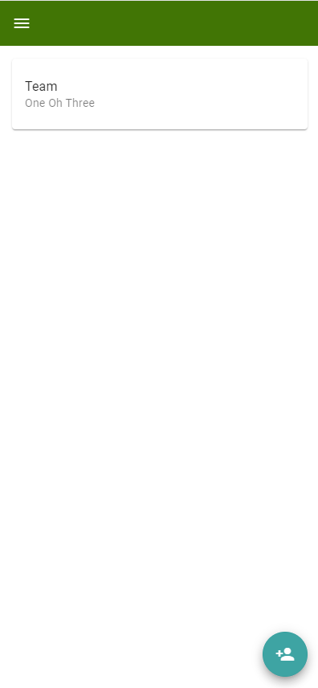
Showing all users.

Slide 38
Recipes

Slide 39
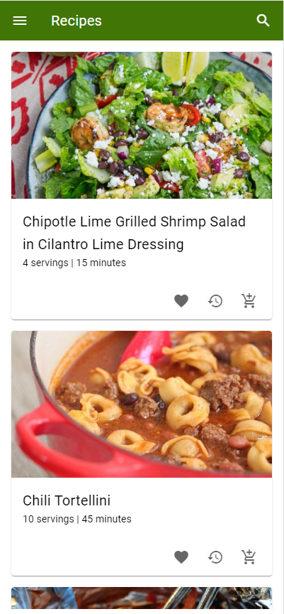
Showing all recipes.

Slide 40
Carts

Slide 41
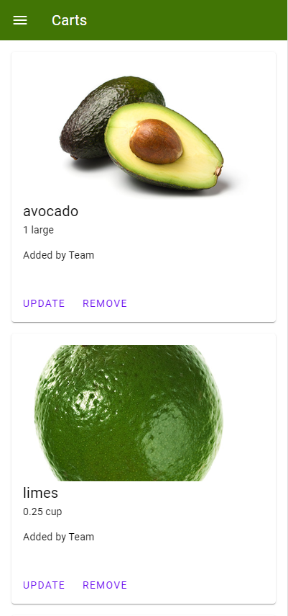
Showing all carts.

Slide 42
Meal Plans

Slide 43
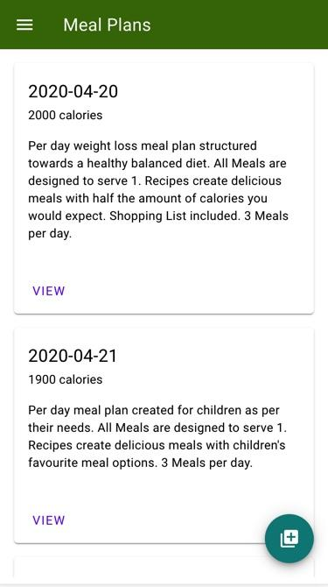
Showing all meal plans.

Slide 44
Inventory

Slide 45
Walkthrough

Slide 46
http://team103.dds.net/horizontal-prototype/
HTTP or HTTPS

Slide 47
Q & A

Slide 48
THANK YOU.

